Slide 1
亚历克上 - M202161029
2021 - 2024
THESIS PROPOSAL
-
information and communication department
-
ustb
PROFESSOR:黄旗明

Slide 2
PRIVACY-PRESERVING SCHEME FOR THE VIRTUAL REALITY AVATARS IN METAVERSE.
Definition of terms?
Why is Metaverse Useful?
Example of metaverse’s?
Security Vulnerabilities.
Fully Homomorphic Encryption(FHE).
Differential Privacy(DP).
Combining FHE & DP).
Limitations.
Research Significance.
Time Frame.

Slide 3
Definition Of Terms
PRESERVING-PRIVACY SCHEME FOR THE VIRTUAL REALITY AVATARS IN METAVERSE.
Metaverse
Virtual Reality(VR)
Avatars
Preserving-Privacy Scheme

Slide 4
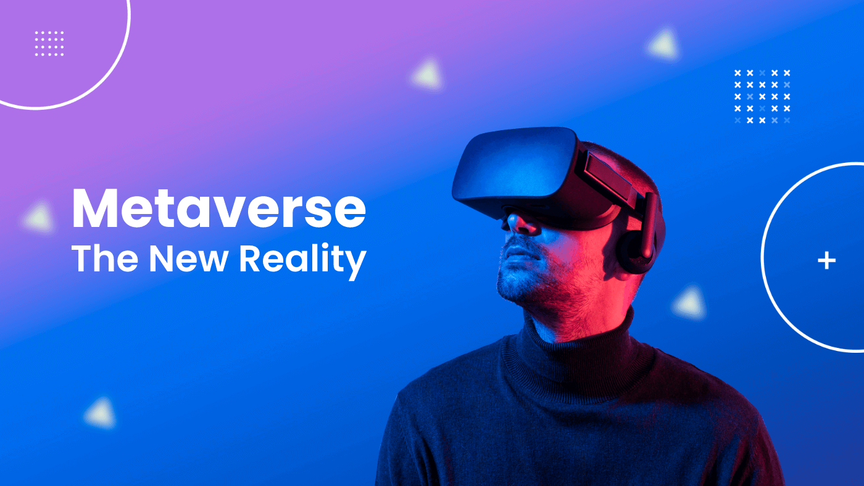
What is the Metaverse? The Metaverse is a spatial computing platform that provides digital experiences as an alternative to or a replica of the real world, along with its key civilizational aspects like social interactions, currency, trade, economy, and property ownership—found on a bedrock of blockchain technology.

Slide 5
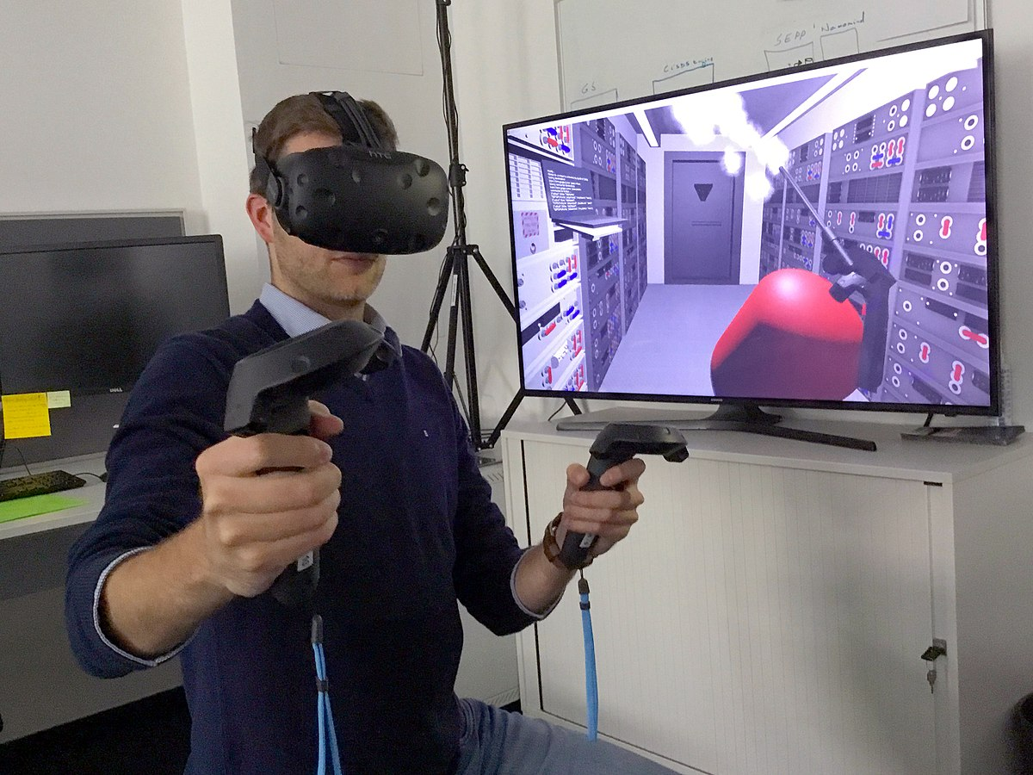
Virtual Reality(VR)? - Is used for interconnected virtual communities where people can socialize, collaborate, and have fun. - using virtual reality headsets, augmented reality glasses, smartphone apps.

Slide 6
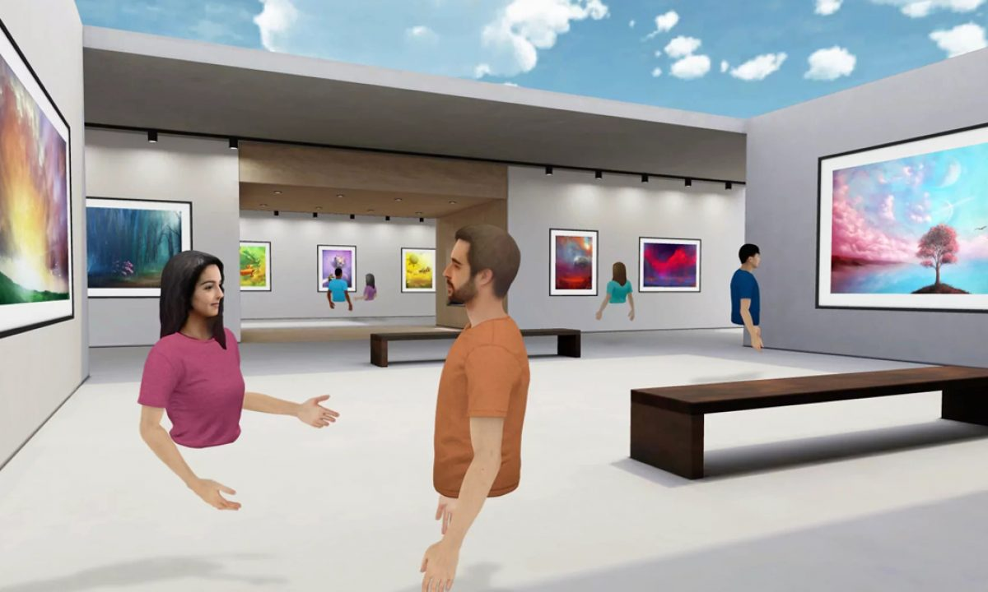
Avatar
On the metaverse, there are many various sorts of avatars, including 2D, 3D, and VR avatars that all resemble humans. All of these avatars have one thing in common: they all gather more user information than websites do.

Slide 7
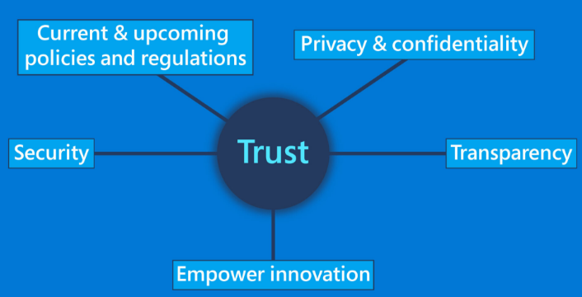
Preserving-Privacy
Privacy preserving technologies allow users to protect the privacy of their personally identifiable information provided to and handled by service providers or apps, all while allowing marketers to maintain the functionality of data-driven systems.

Slide 8
WHY METAVERSE IS USEFUL?

Slide 9
MAIN 4 REASONS
Experience
Discovery
Metaverse will provide people with a wide range of experiences we cannot currently enjoy.
Through app shops, search engines, and rating websites, customers can learn about new platforms thanks to this layer.
Human interfacing
Decentralization
The hardware layer of the Metaverse must include human interfacing. Any virtual world can accept a person’s body as a 3D, realistic avatar.
There won’t be a single authority that rules the Metaverse. Scalable ecosystems will support business owners in providing a more comprehensive range of specialized digital items as the Metaverse expands, enabled by blockchain technology.
Human interfacing
Infrastructure
Creator economy
Spatial computing-mixed reality (MR), virtual reality (VR), and augmented reality (AR)= External reality(XR)

Slide 10
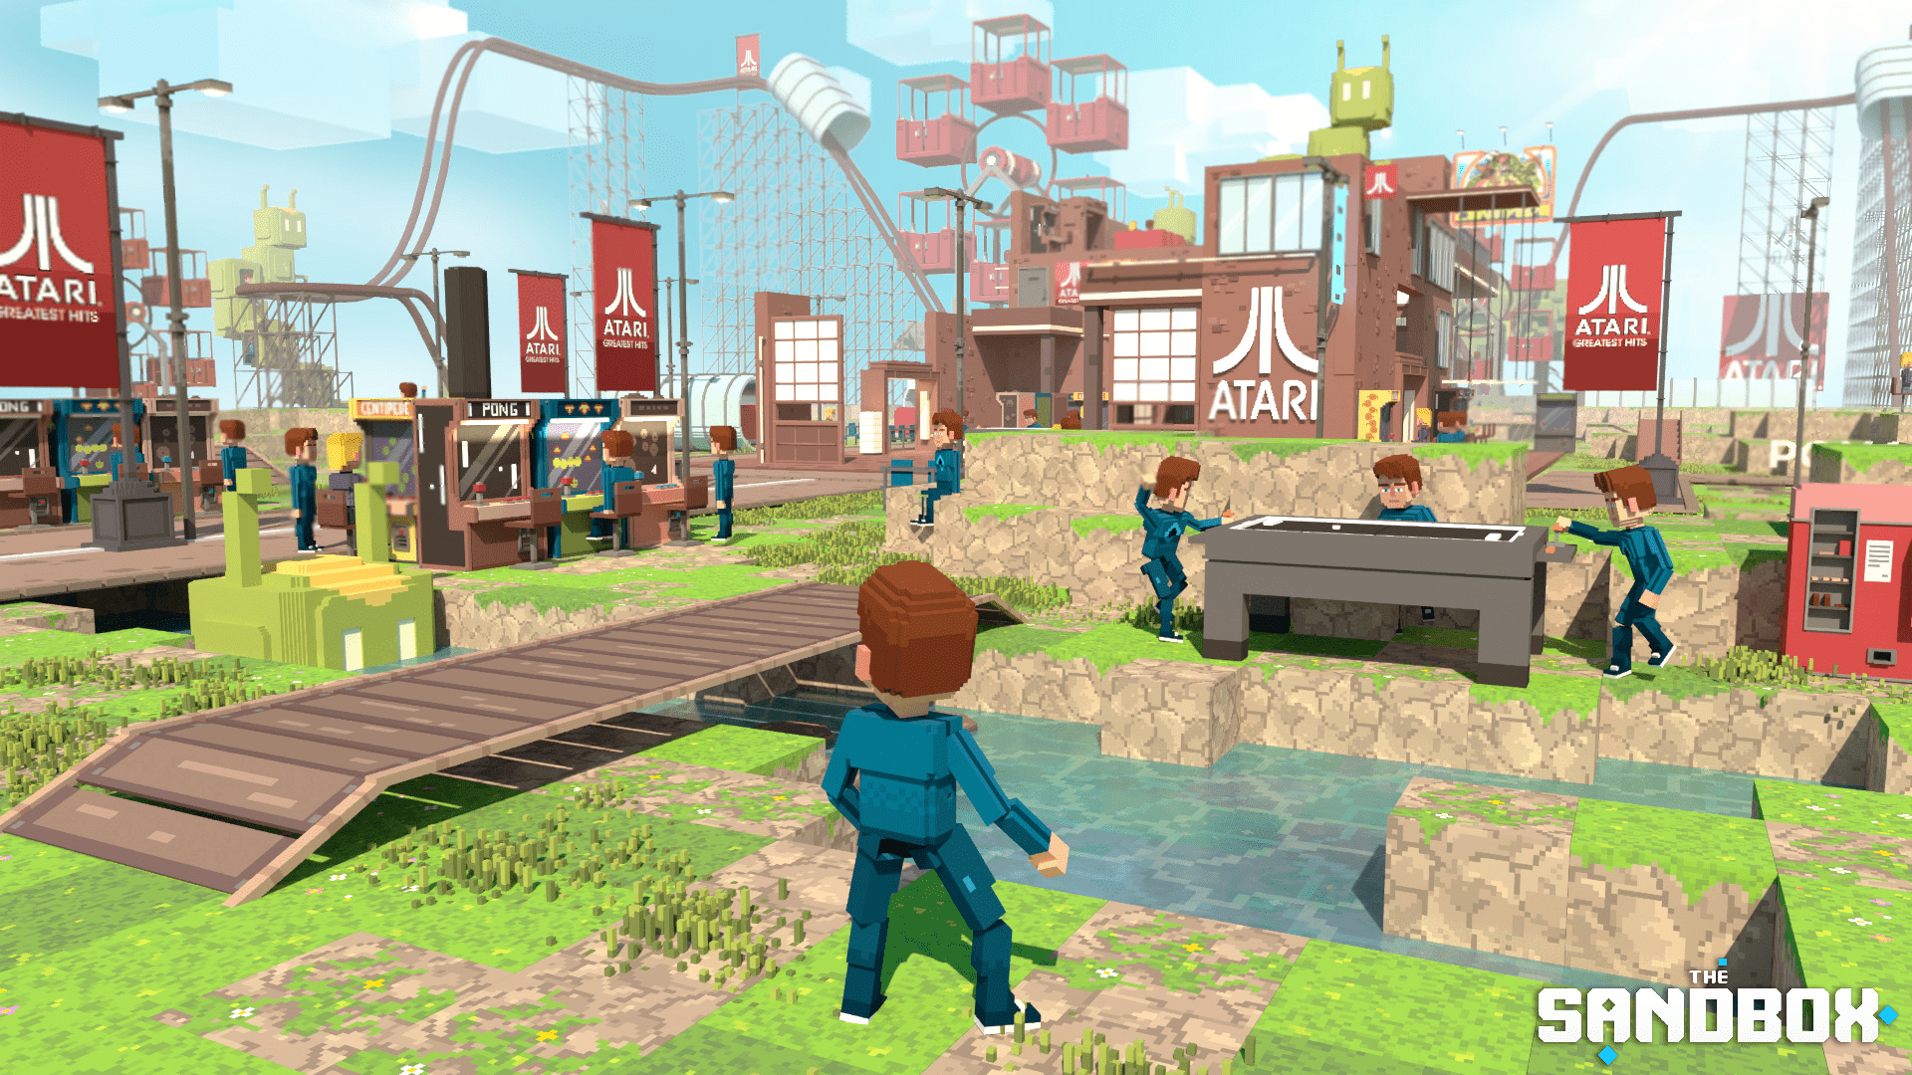
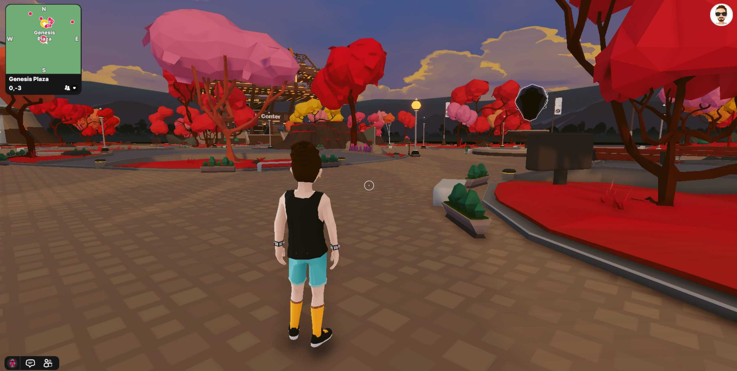
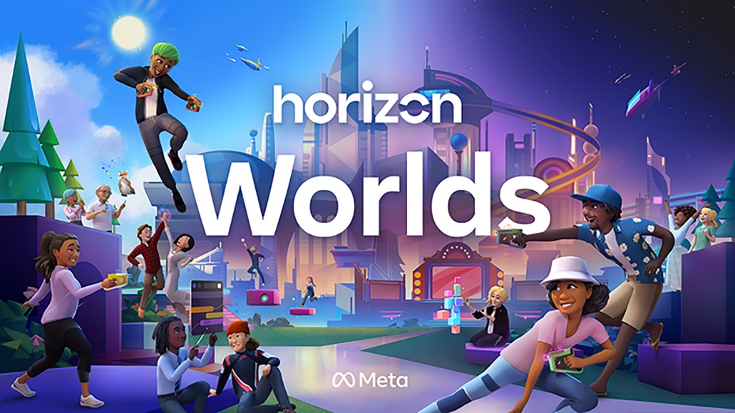

Examples Metaverse platforms
The Sandbox
Decentraland
Meta Horizon Worlds
Bloktopia

Slide 11
SECURITY VULNERABILITIES
1. Sensitive data exposure.
• during data collection by metaverse hardware.
• when data is transferred from the user's server to the developer's server.
• during training models and analysis.
2. Server-side Request Forgery.
3. Users data rights and ownership.
4. Lack of Privacy Regulations.
5. Intrusive and extensive data collection.
6. User to user privacy.

Slide 12
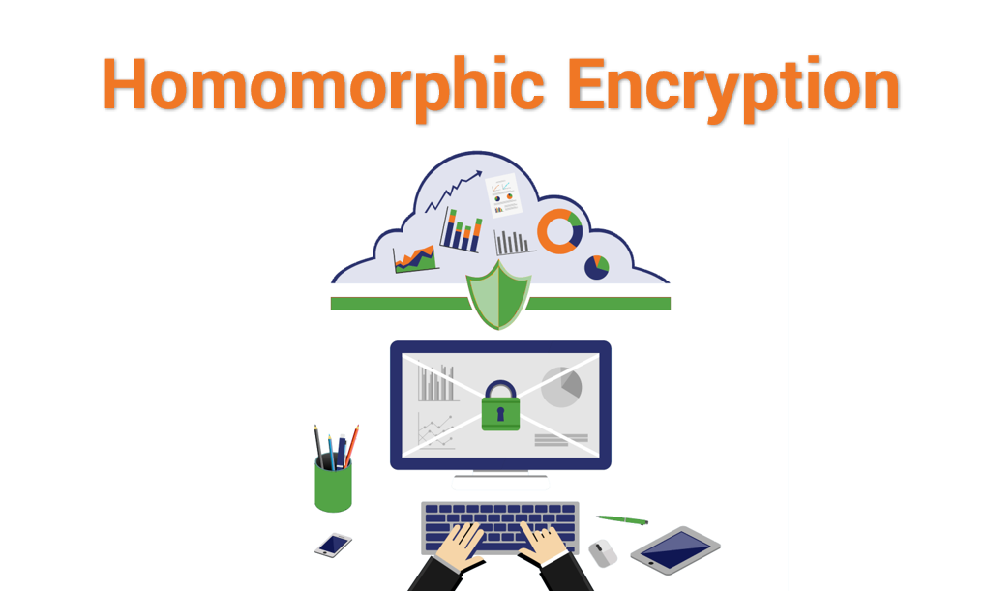
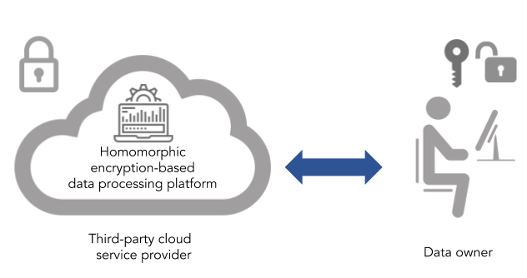
Fully Homomorphic Encryption(FHE)
permits users to perform computations on its encrypted data without first decrypting it.
We will be using gentry’s system.
We will study the Craig Gentry algorithm.
Lattice is the best system we will use since it compatible with Rappor.

Slide 13

Differential Privacy(DP)
. It allows data to be secured from the time it is collected from the environment.
All three types of Privacies (Information privacy, communication privacy and individual privacy) can be well protected by differential privacy on the host device.
The best tool is Google's differentially private reporting tool Rappor.

Slide 14
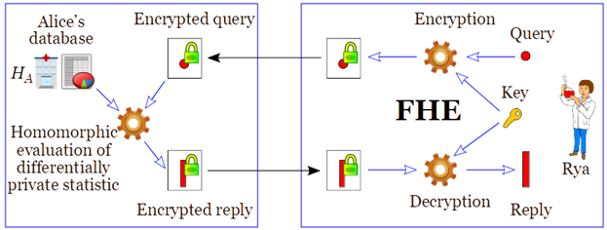
Combining (FHE & DP)
We propose to combine (FHE) and (DP) together to create a new scheme that will work as a bridge between users and metaverse companies. This new scheme derives group privacy from differential privacy, and on FHE, we only consider key generation, encryption, and decryption, the three algorithms that comprise a general public key_encryption method. Let pk be a public key produced by key_generation, and let m be a plain message. We refer to the encrypted data as the ciphertext [[m]]pk (m, pk). We will ignore the second option and use [m] as we will only be utilizing one public key for the duration of this endeavor, leaving room for (DP).

Slide 15
Limitations
We will probably encounter several blocks while conducting our research. Combining (DP) and (FHE) may appear simple, but there are several restrictions that make it difficult to combine the two schemes into a single efficient scheme. We must disregard certain approaches and concentrate solely on those that are relevant in order to address this issue. It will be challenging if pre-paid data is necessary for the success of this research because all of the data utilized in it comes from open-source sites. We have previously examined every piece of equipment needed for this issue, and as of today, every necessity is within reach.
Naturally, there are two main issues with the system:
It is computationally highly costly (DP).
Naturally, (FHE) is extremely slow since it makes use of big keys to achieve the required level of security. This has been accepted as a trade-off for the successful completion of this research.

Slide 16
Research Significance
Finding fresh approaches to protecting privacy in the metaverse was the goal of this study. Researchers and metaverse businesses will be able to access a wide variety of data for their jobs more readily and without breaking any privacy laws in this way. Users won't be reluctant to offer sensitive information if an appropriate privacy-preserving strategy is used since they won't have to worry about their personal information being compromised. The public also gains from this since it provides an excessive amount of assurance.
The problem mentioned in the preceding section can be mitigated by a number of publicly available, but more has to be done. We know how (DP)’s Group Privacy works, and we also know how (FHE) works. Therefore, it is necessary to create a different strategy that can withstand privacy breaches from both malevolent attackers and computational nodes at the same time, and combining (DP) and (FHE) to form a new privacy-preserving scheme might be the best solution for both data users(collection) and metaverse companies.

Slide 17
Research Timeline
Task and “to do list”
Choose a topic Topic: Privacy-Preserving Scheme For The Virtual Reality Avatars In Metaverse. | 30 Dec 2022
Gather Information
Organize ideas
Create outline
Experimenting time | 6 months
Draft the paper
Revise and fill the gaps
What am I missing? What do I need to change?
Edit

Slide 18
亚历克上 - M202161029
THANK YOU !!!
30/12/2022
PROFESSOR:黄旗明

